Slide 1
core_scenario
Pipeline: NE Core Scenario
Vessel Pathway: Common
Port Pathway: Common

Slide 2
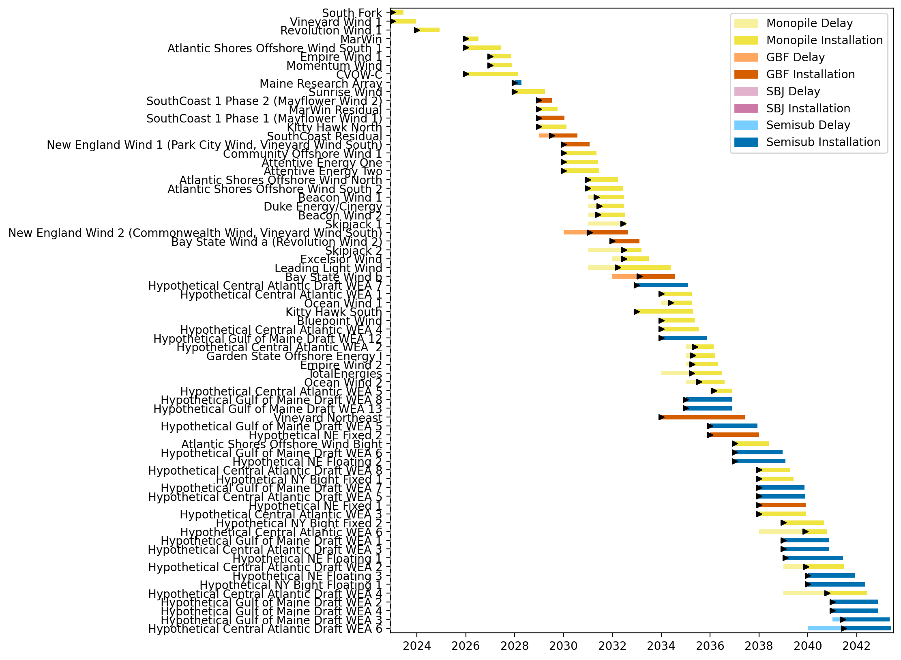
Full Gantt

Slide 3
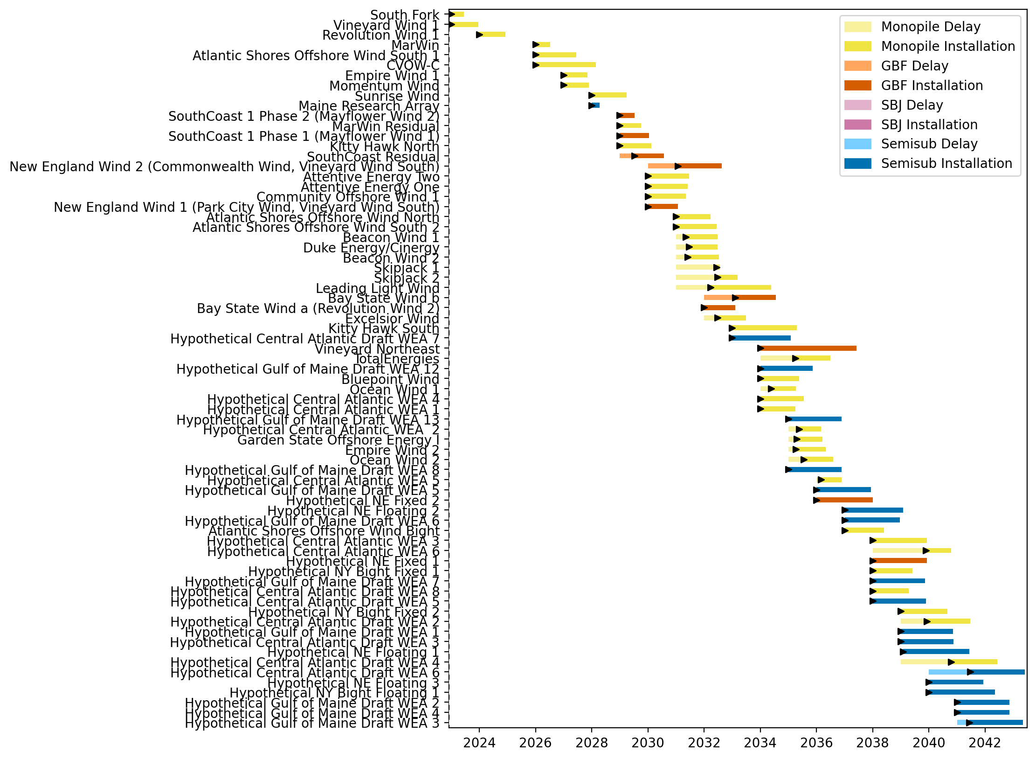
Sorted Full Gantt

Slide 4
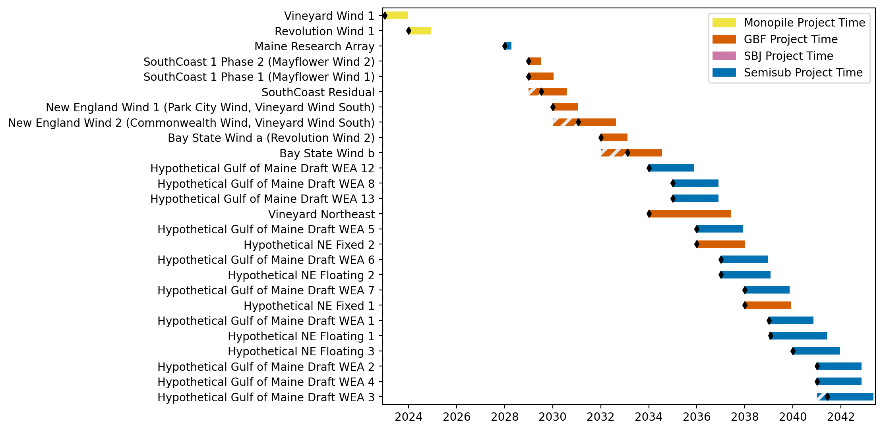
New England Gantt

Slide 5
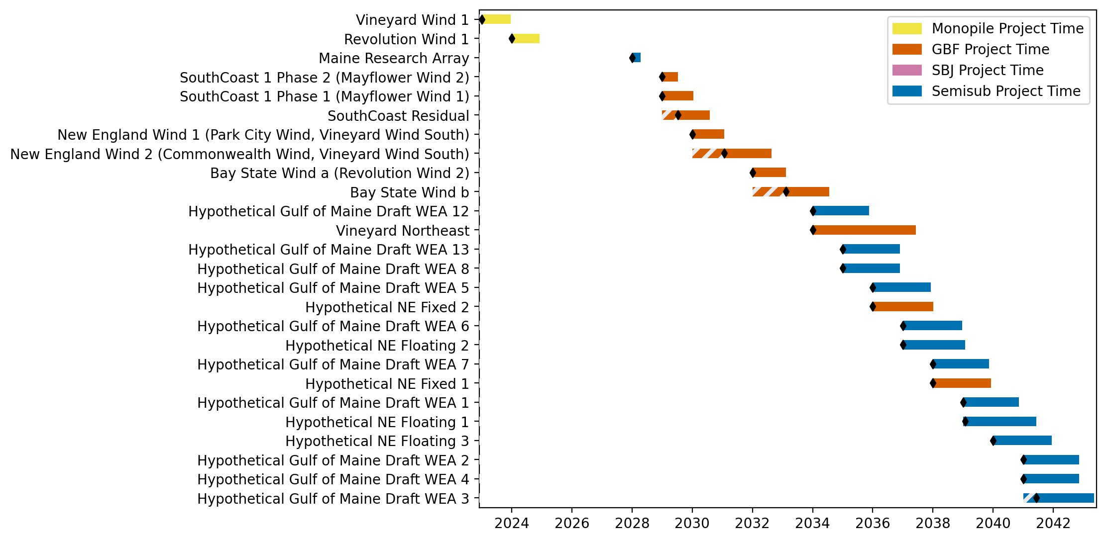
Sorted New England Gantt

Slide 6
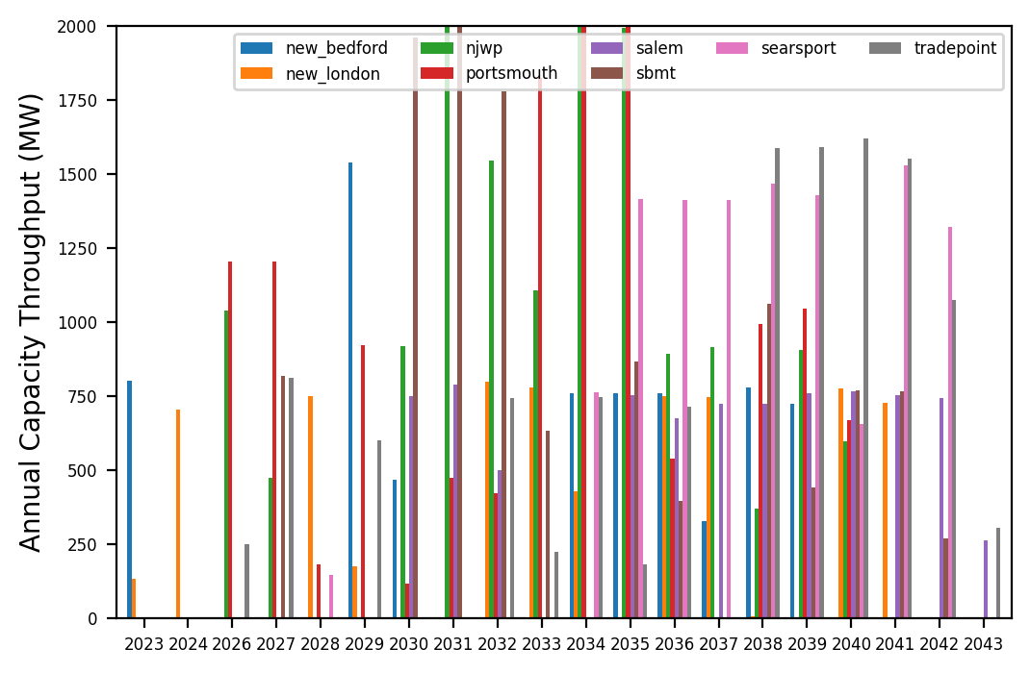
Port Throughput

Slide 7
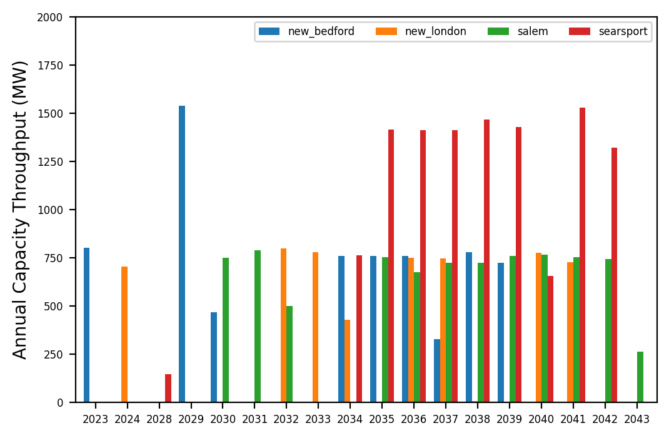
Port Throughput

Slide 8
high_gbf
Pipeline: Best Path Foward
Vessel Pathway: Common
Port Pathway: Common

Slide 9
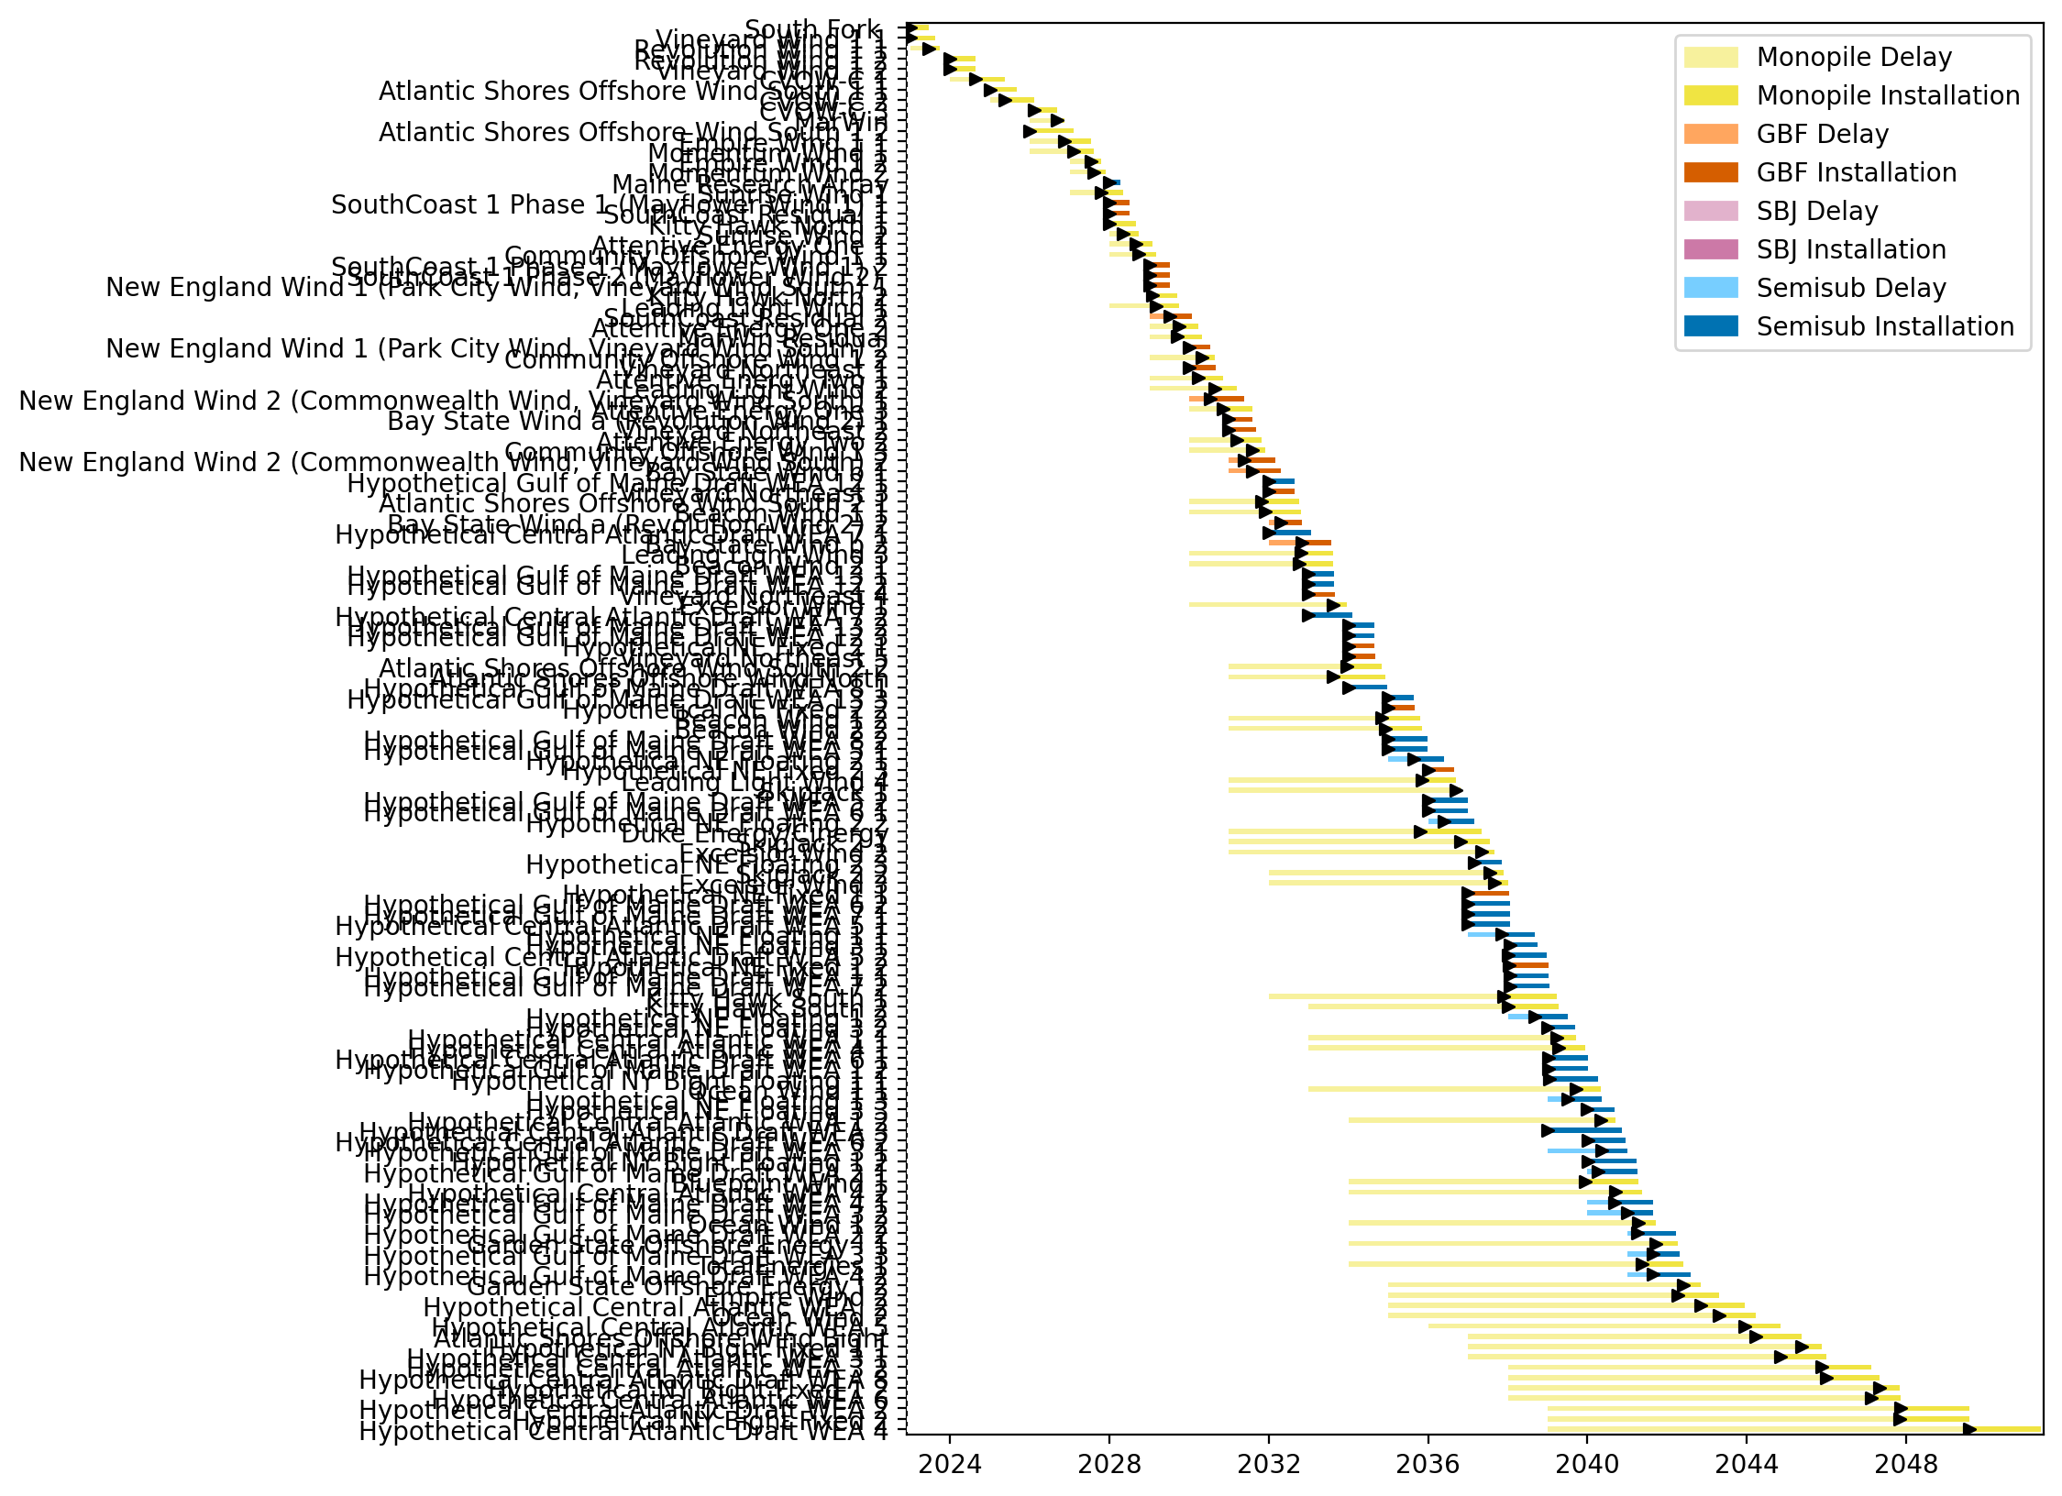
Full Gantt

Slide 10
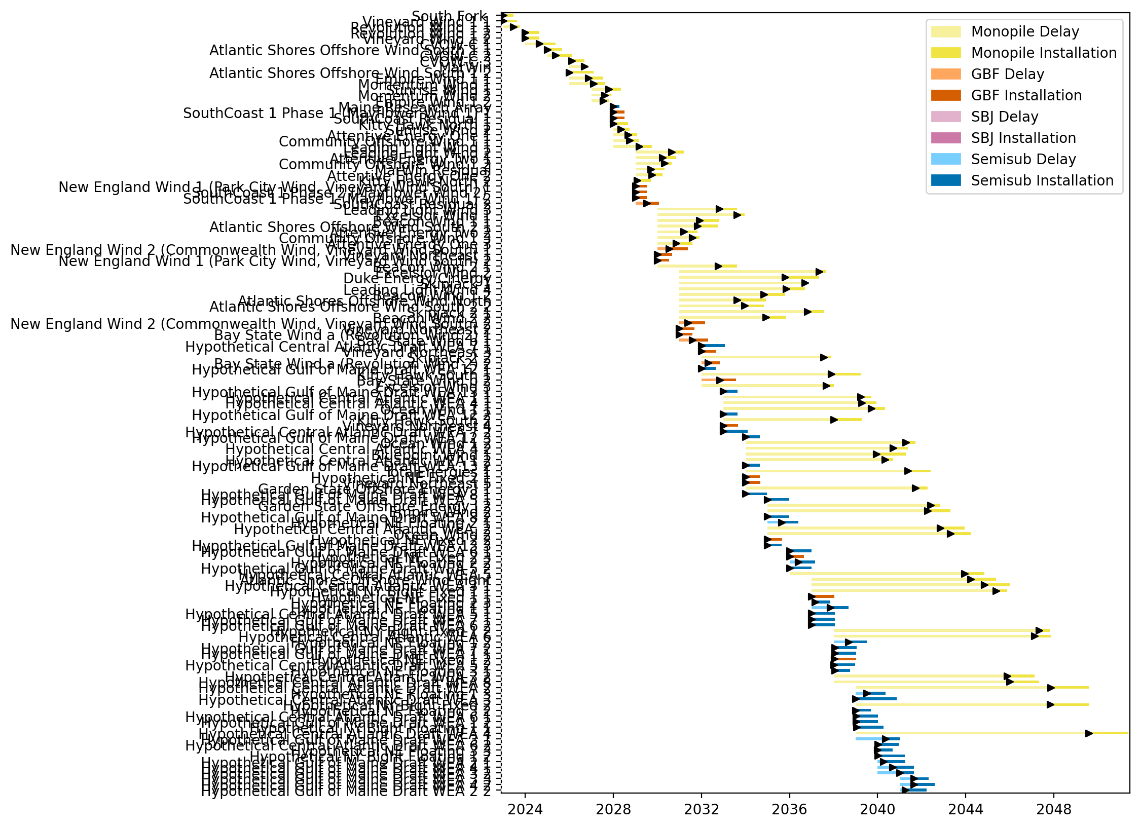
Sorted Full Gantt

Slide 11
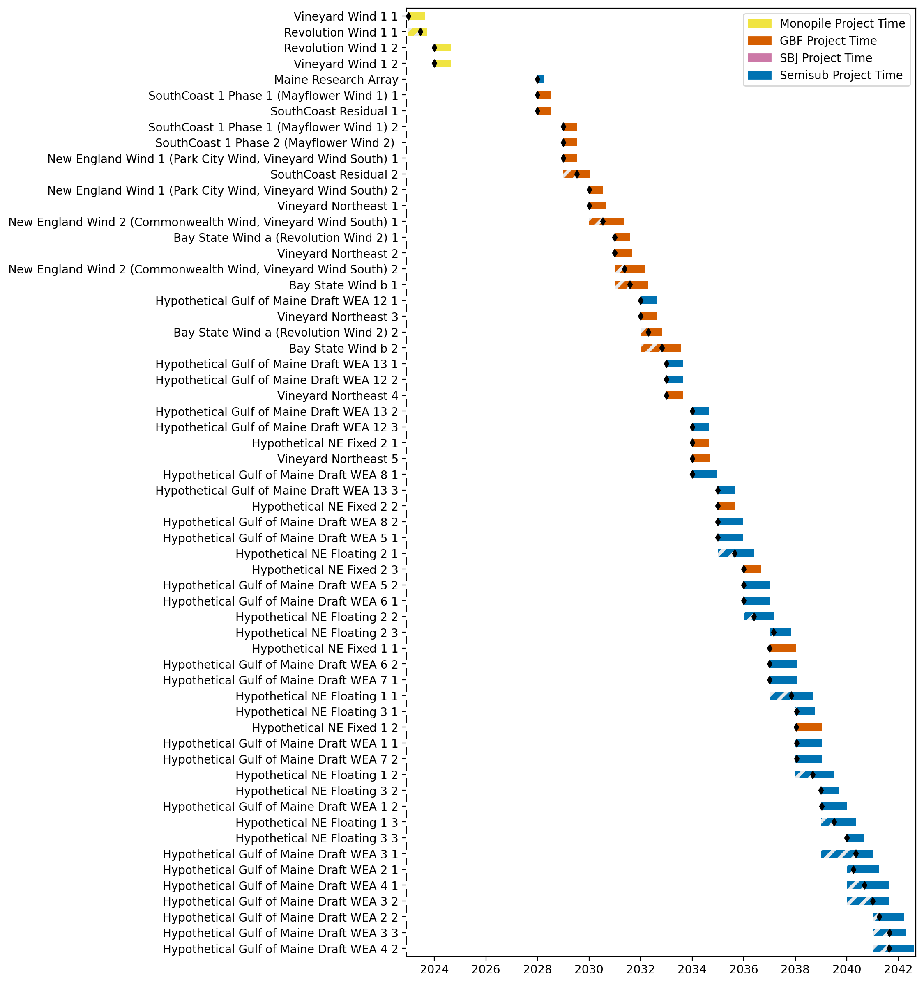
New England Gantt

Slide 12
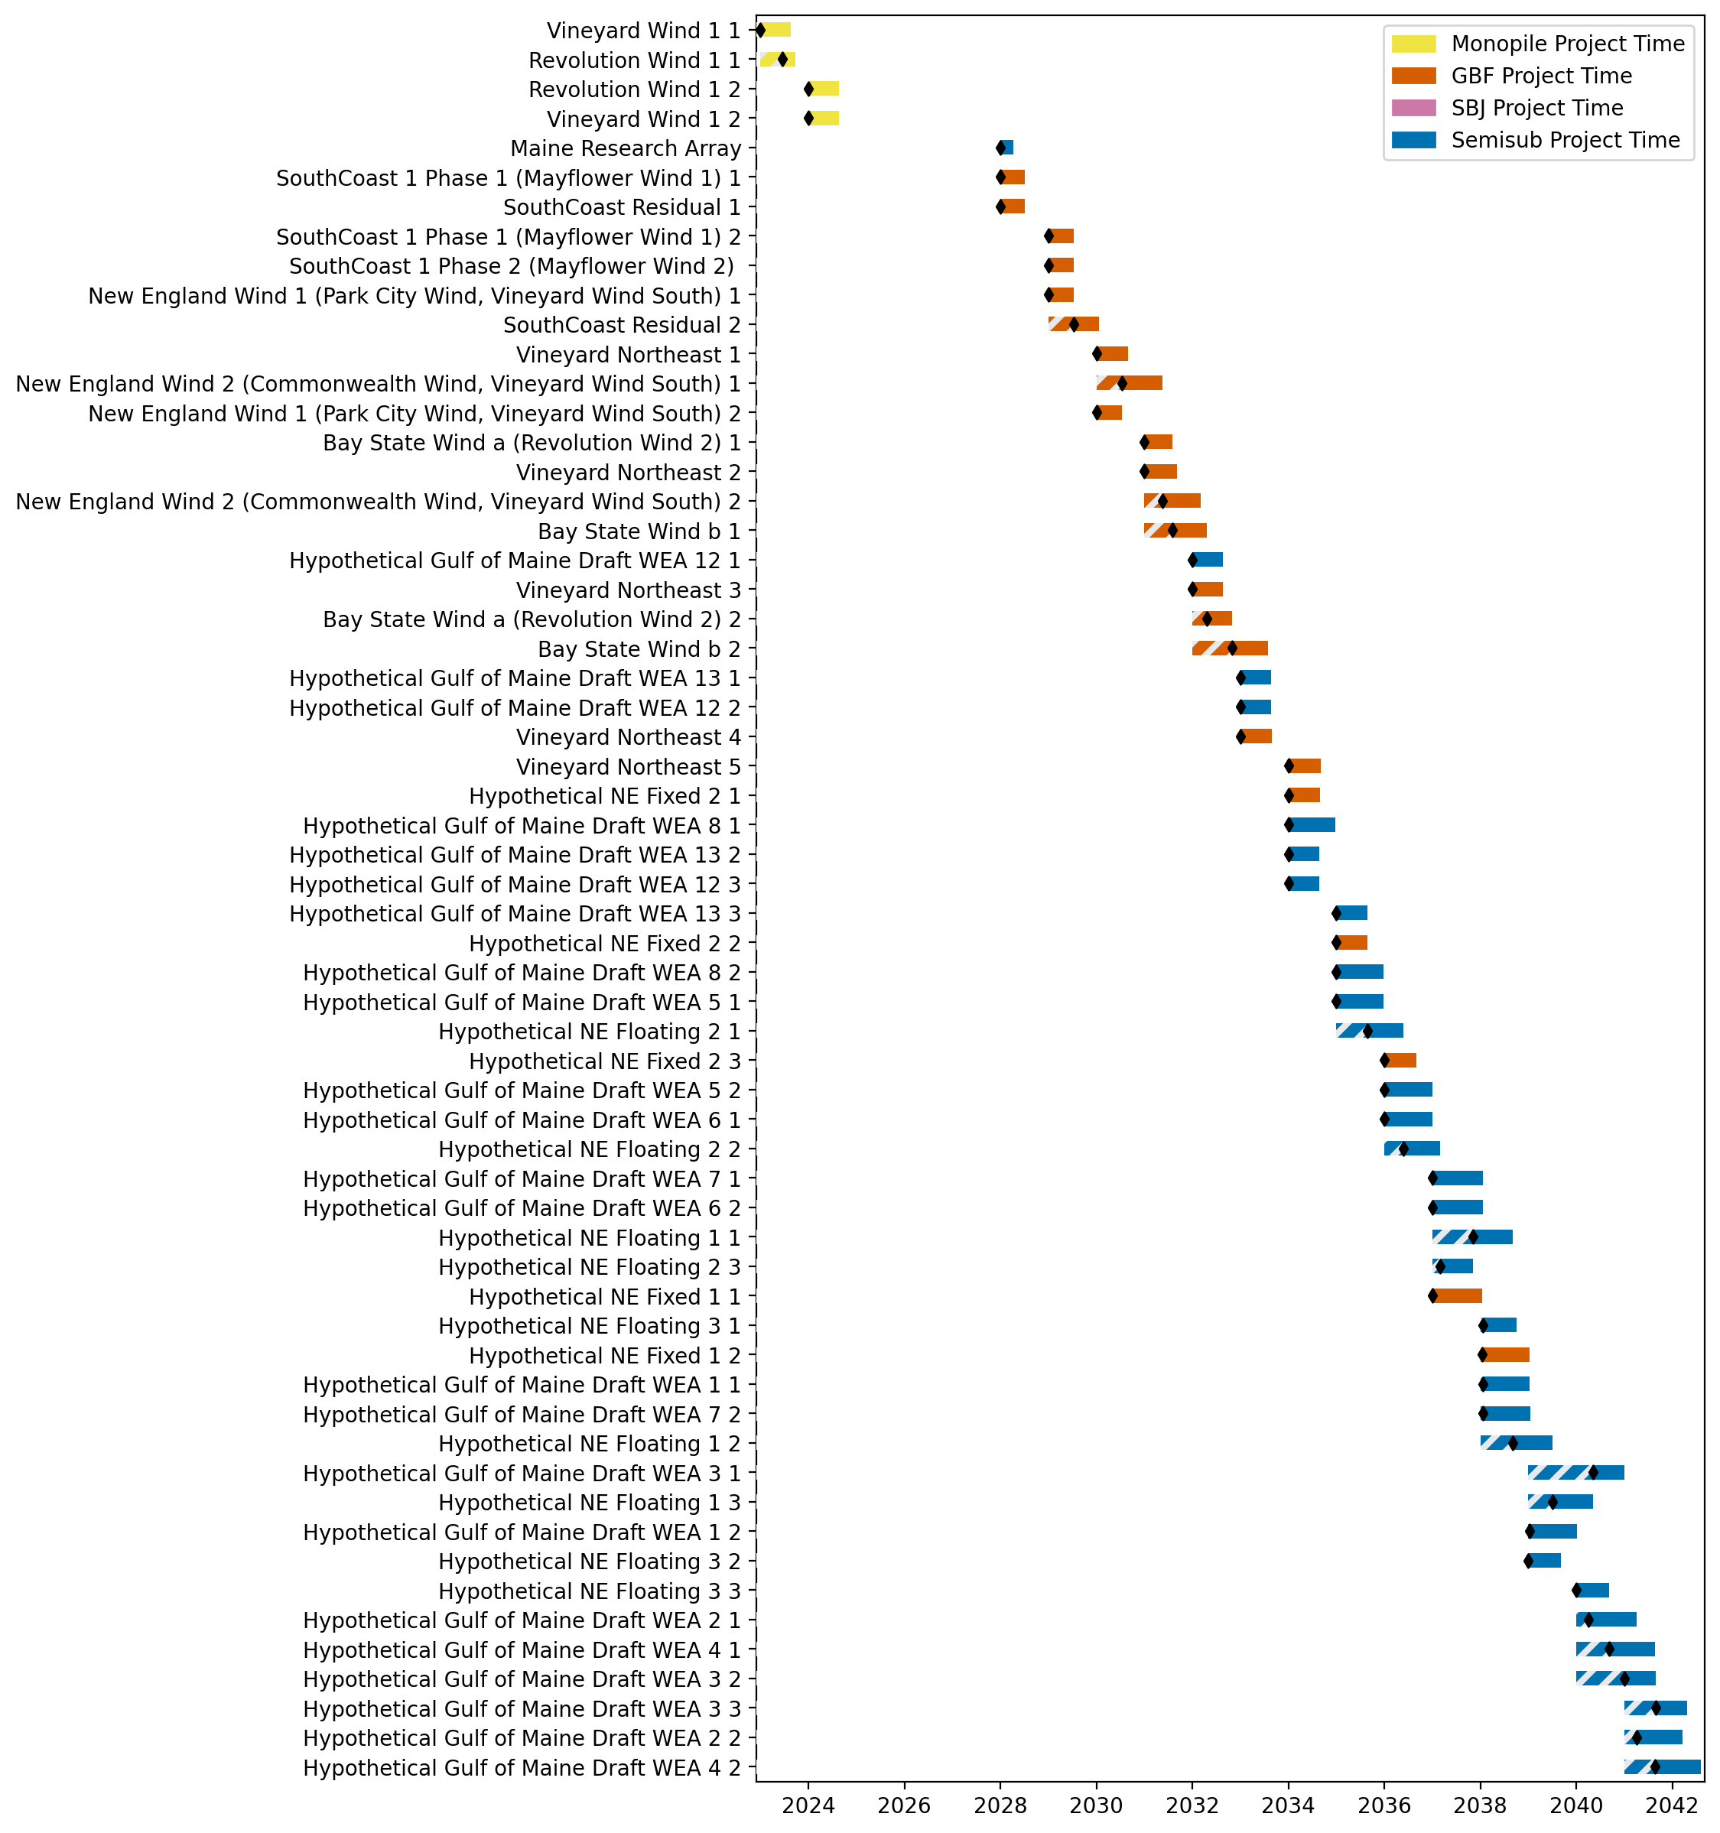
Sorted New England Gantt

Slide 13
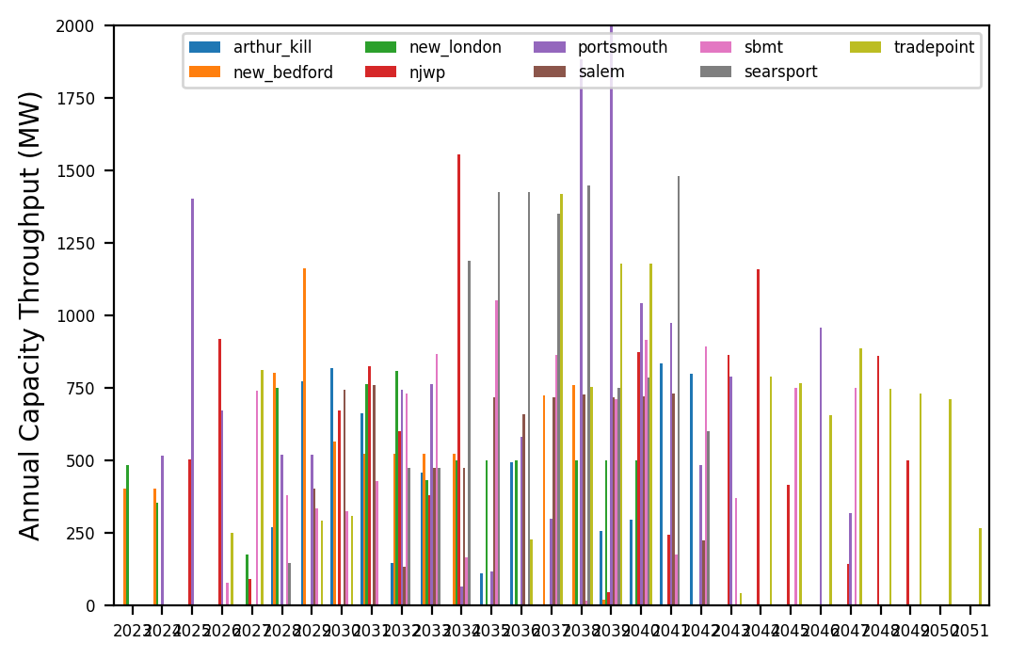
Port Throughput

Slide 14
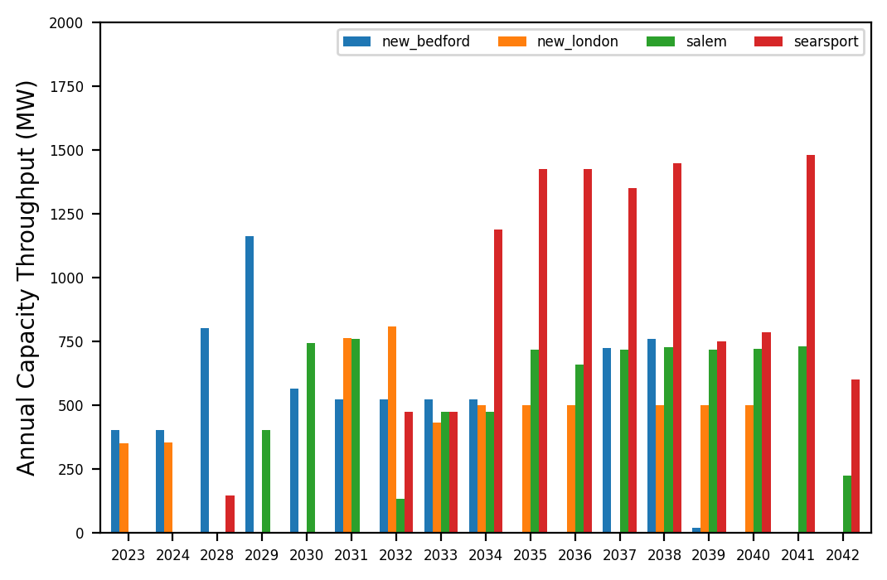
Port Throughput

Slide 15
coral_ex
Pipeline: Best Path Foward
Vessel Pathway: Common
Port Pathway: Common

Slide 16
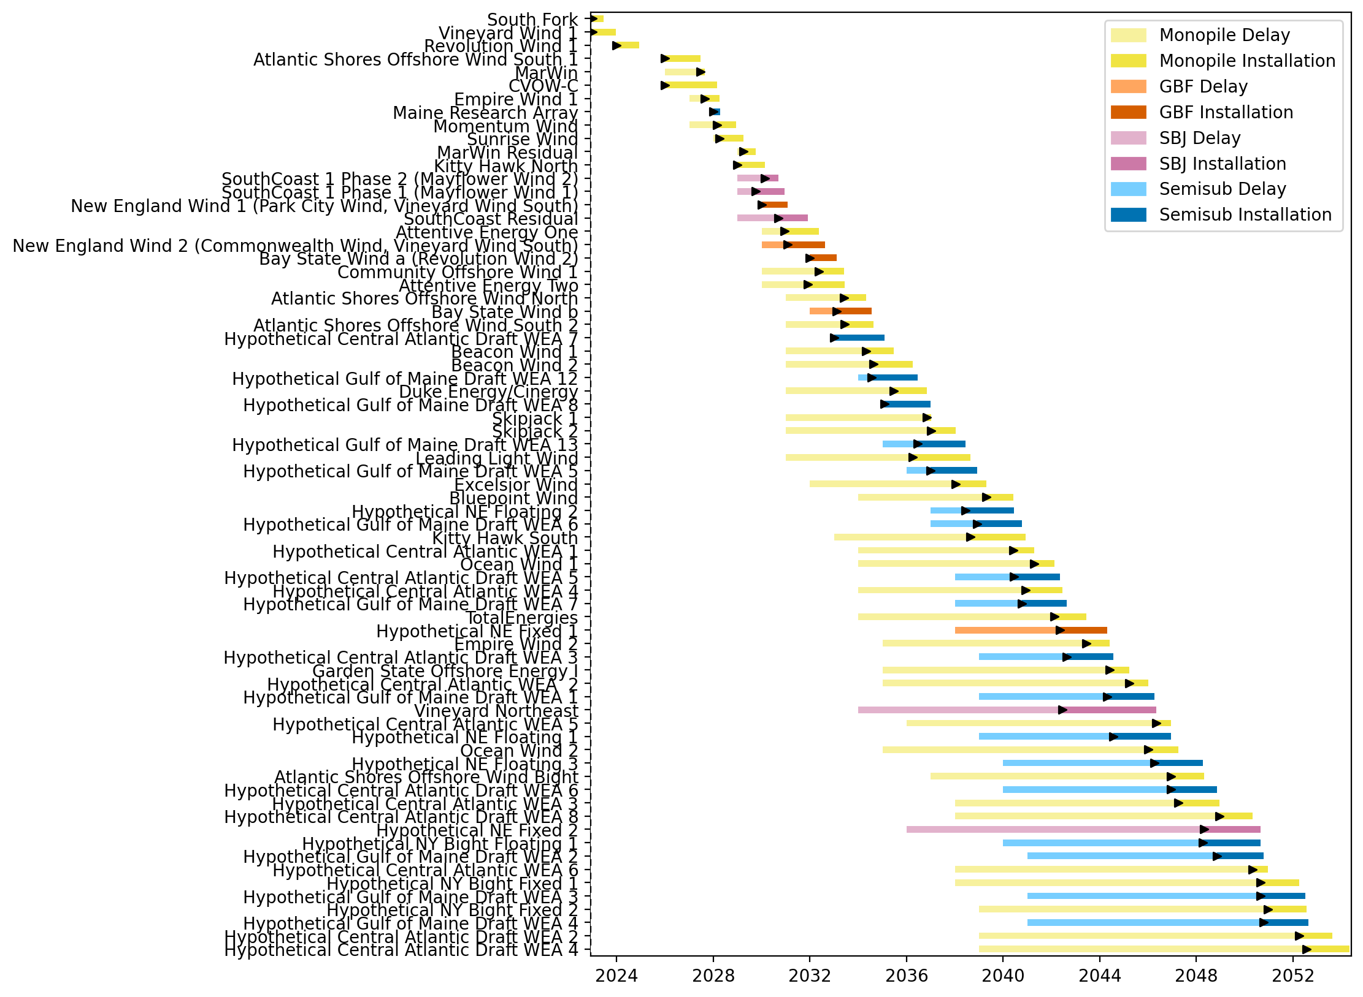
Full Gantt

Slide 17
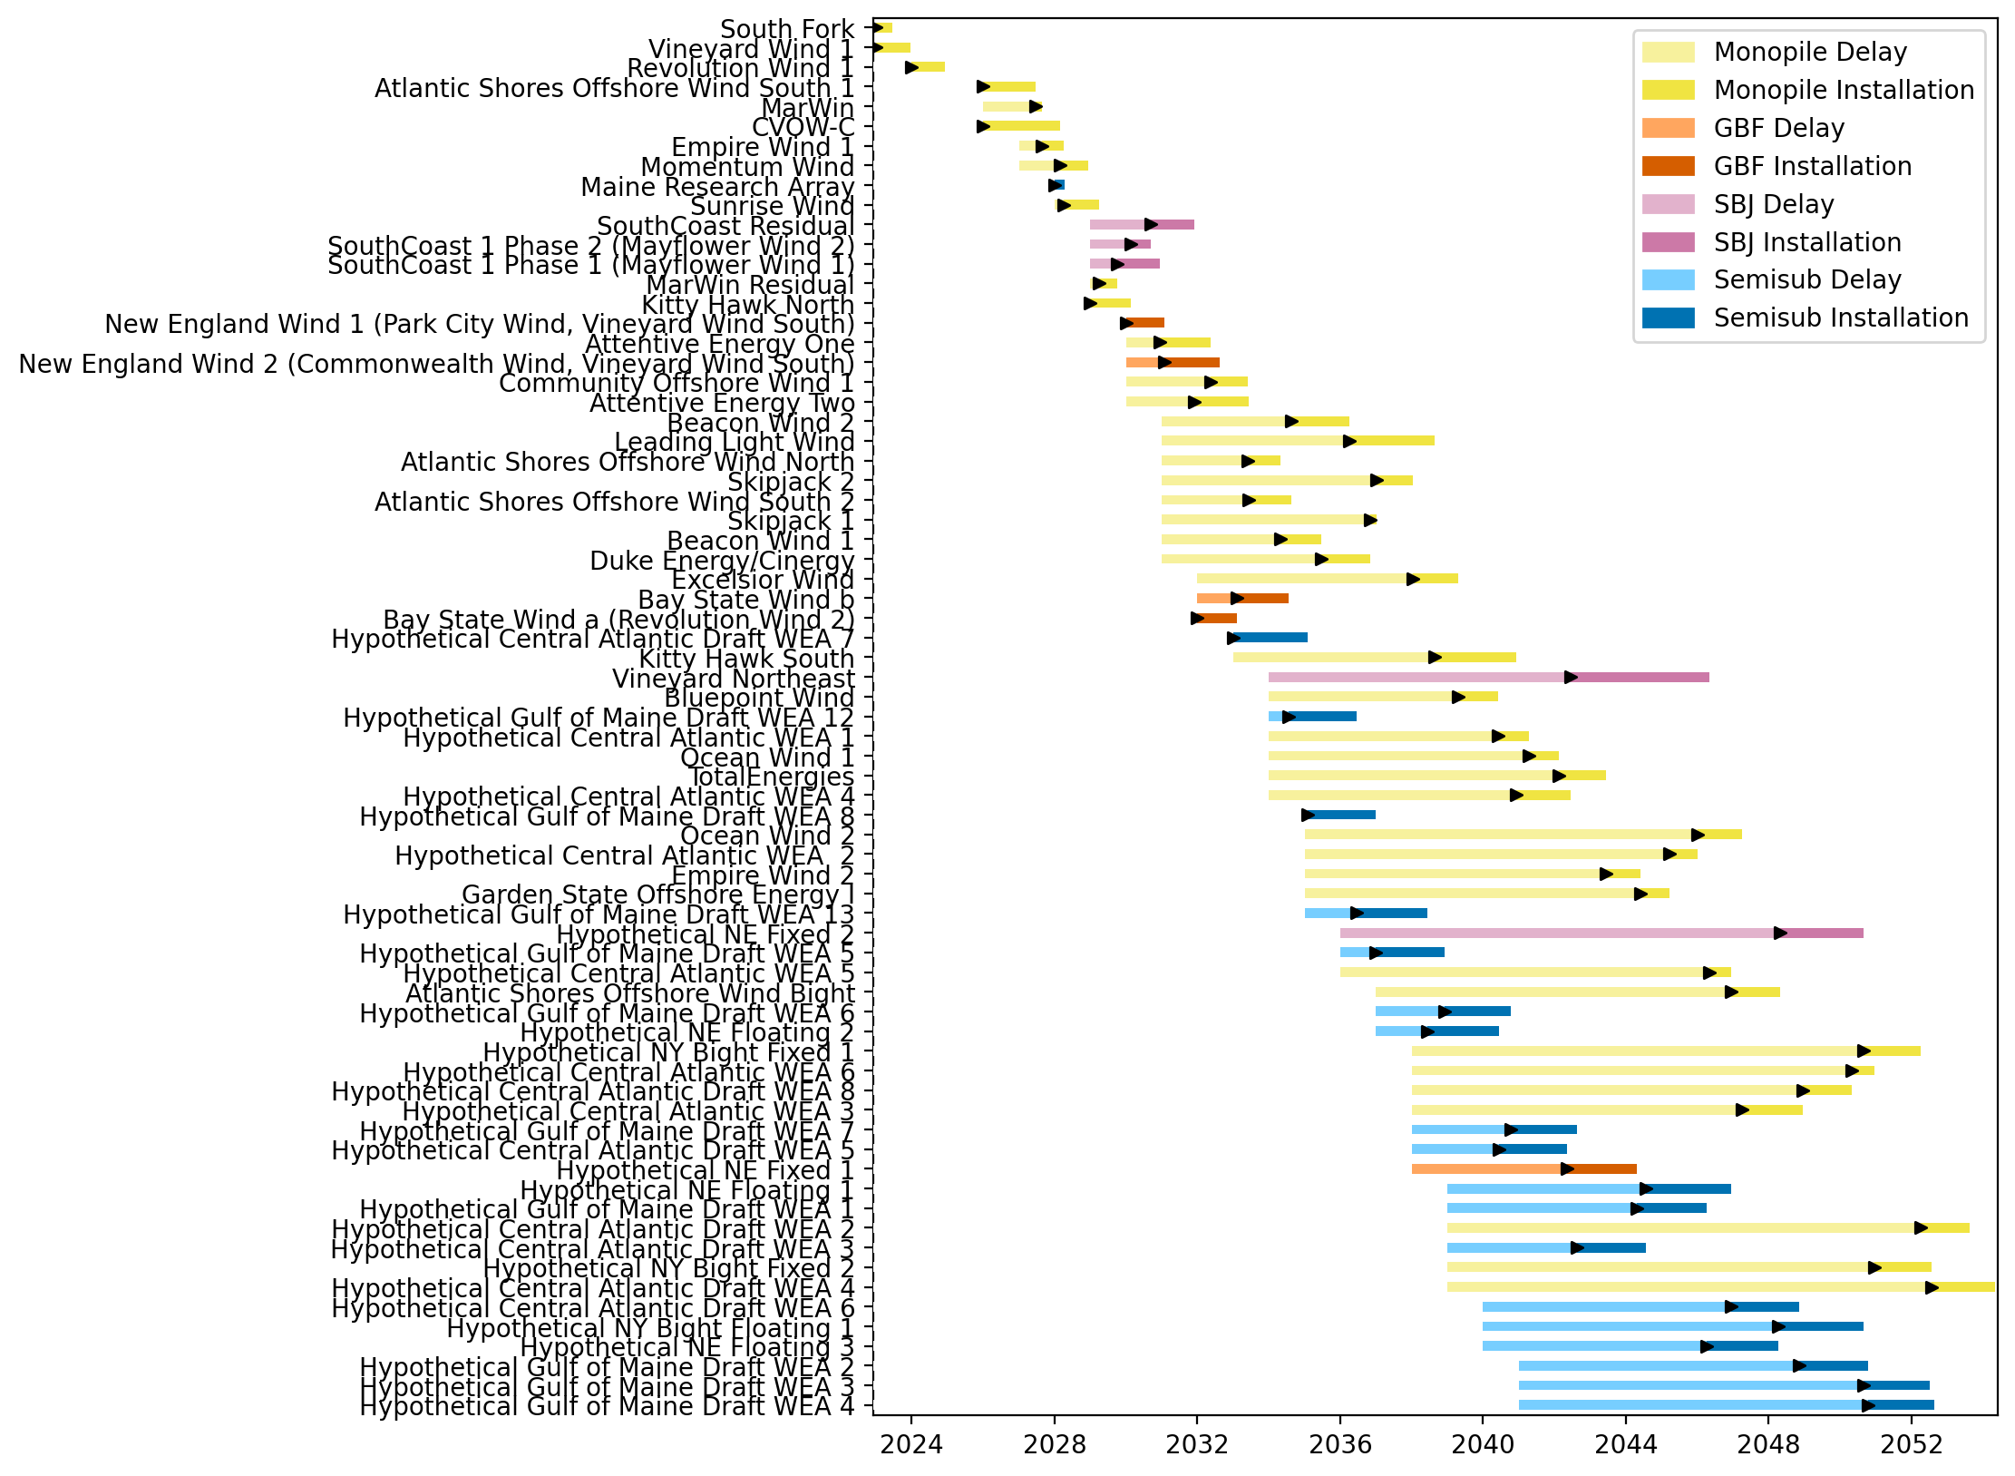
Sorted Full Gantt

Slide 18
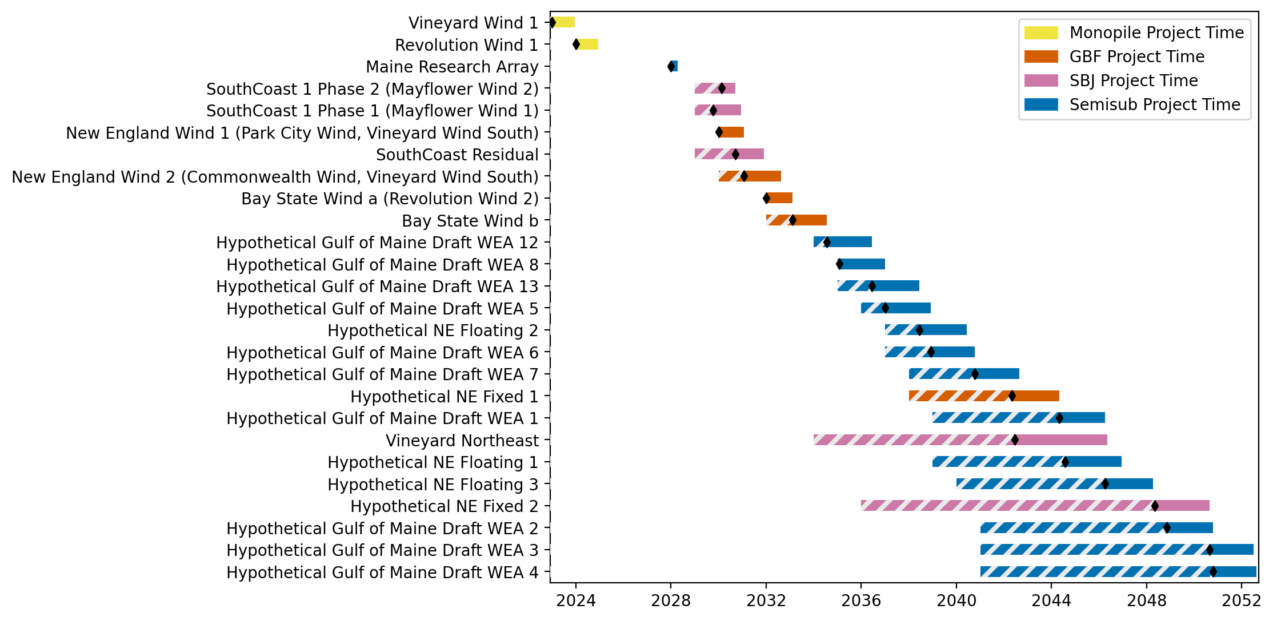
New England Gantt

Slide 19
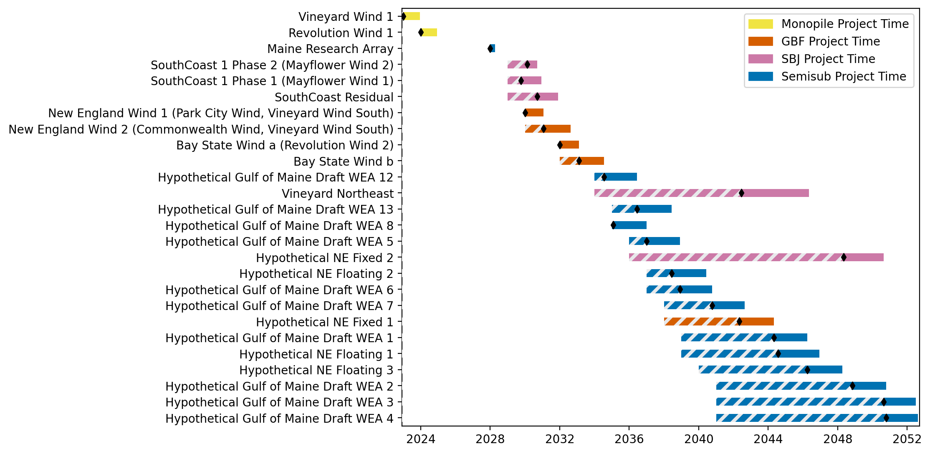
Sorted New England Gantt

Slide 20
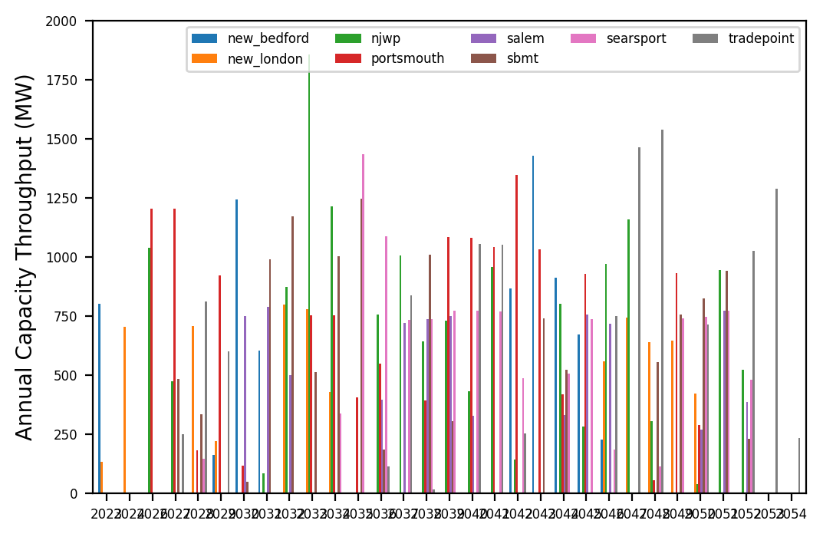
Port Throughput

Slide 21
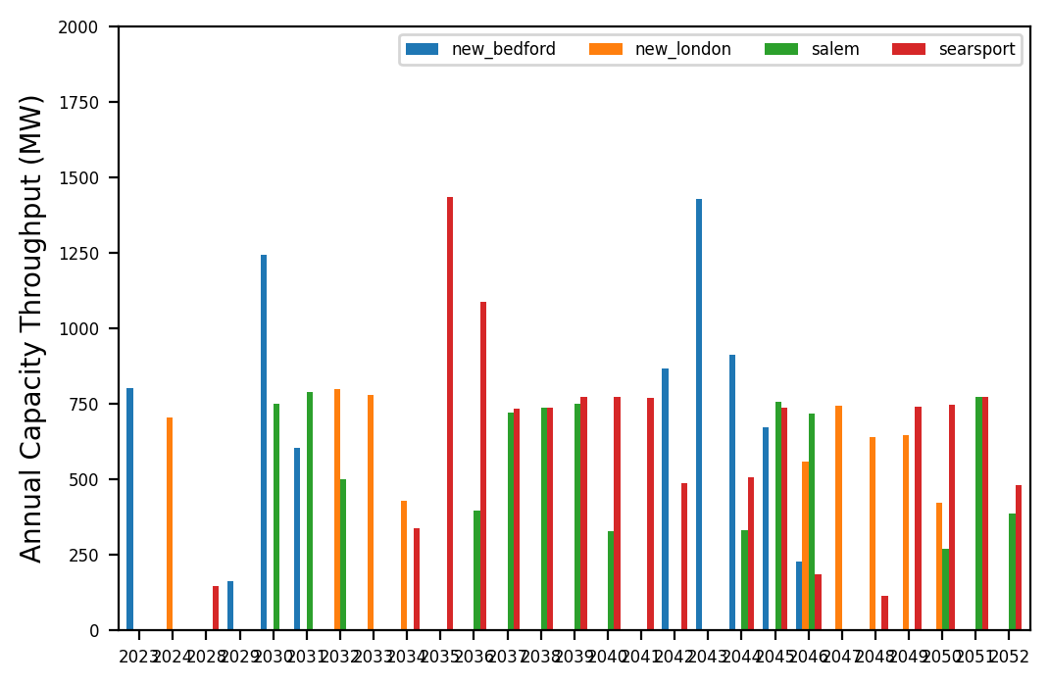
Port Throughput

Slide 22
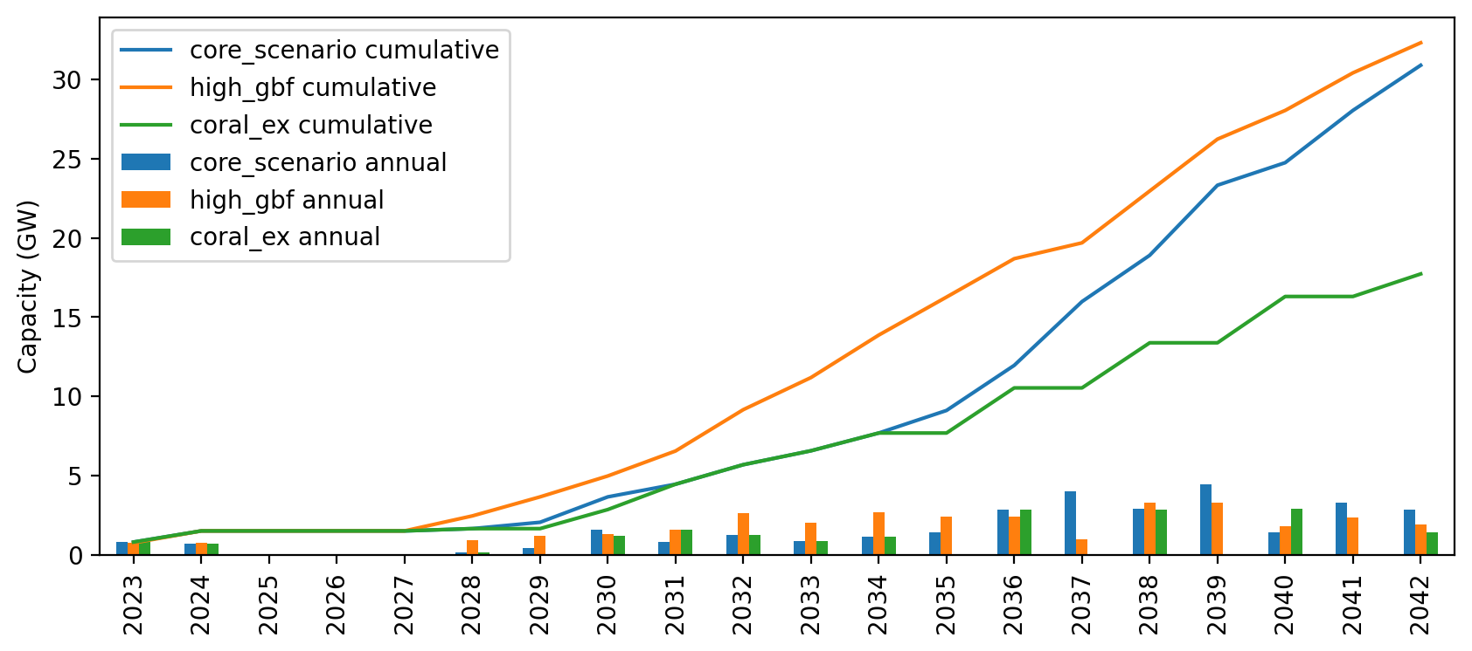
Installed Capacity

Slide 23
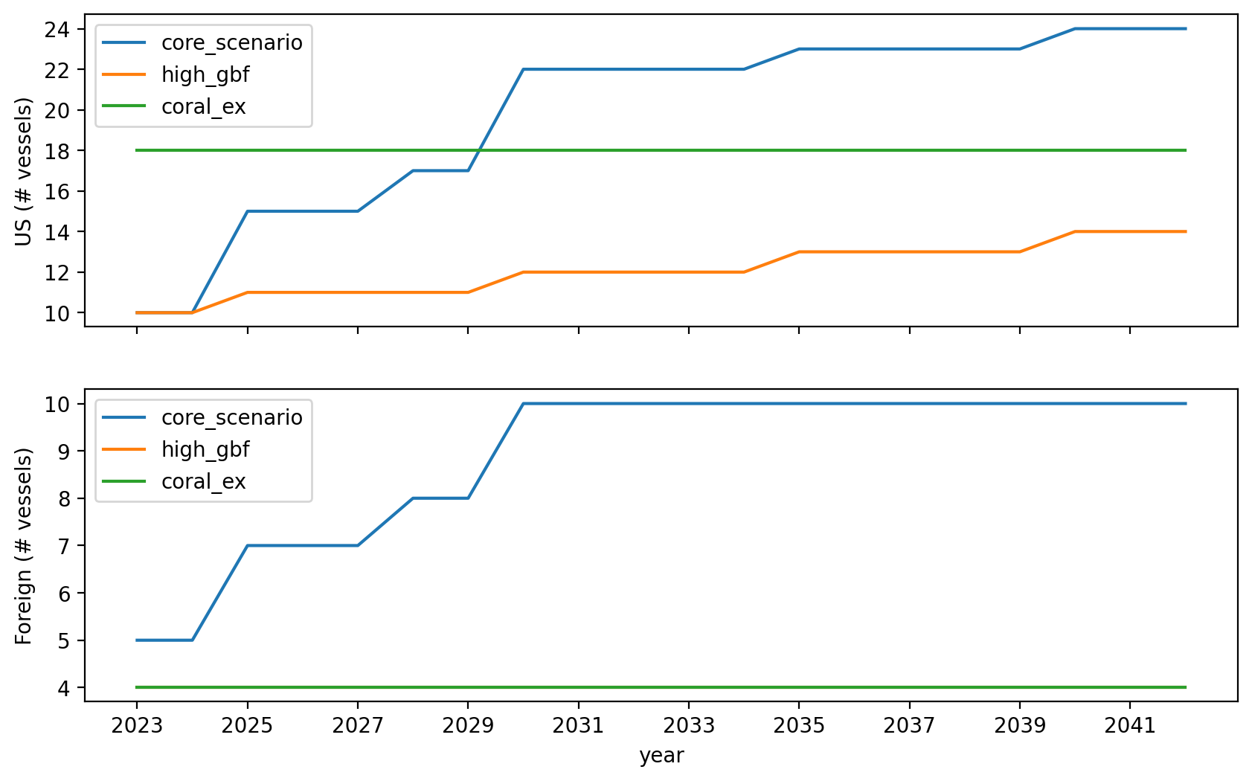
Vessel Investment

Slide 24
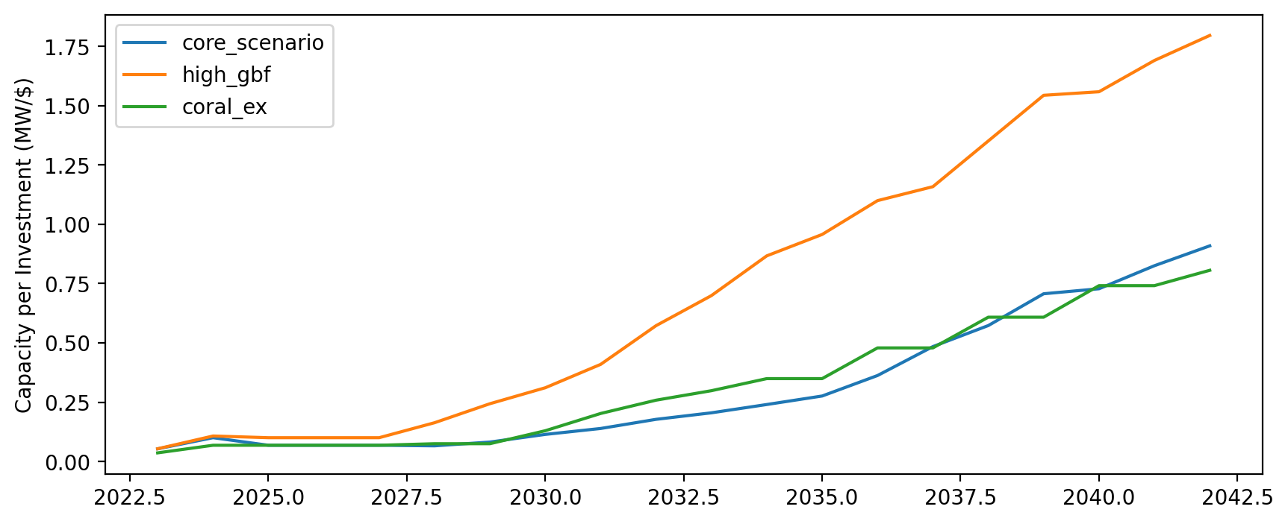
Capacity per Investment (MW/$)

